Slide 1
UiPath Process Mining (formerly ProcessGold)
Advanced Training
Overview for Partners
Notes:
Hello, and welcome to our Advanced Training on UiPath Process Mining (formerly ProcessGold).

Slide 2

Learning Objectives
After completing this course you will be able to:
Identify opportunities for UiPath Process Mining
Describe the Value of UiPath Process Mining to our Customers
Differentiate UiPath Process Mining vs our Competition
Access Additional Resources
Notes:
After completing this course ​you will be able to:
Identify opportunities for UiPath Process Mining
Describe the Value of UiPath Process Mining to customers
Differentiate UiPath Process Mining vs Competition
Access Additional Resources

Slide 3








Where Does Process Mining fit within UiPath’s RPA Platform?
UiPath Process Mining gives you data-driven insights and understanding of complex end-to-end processes, to continuously optimize and accelerate automation in the context of processes.
The product belongs to the “Discover” stage of the RPA platform
Connect
Discover
Build
Manage
Run
Engage
Measure
Notes:
Let’s begin with showing where Process Mining fits in the UiPath Platform.
Process Mining is part of the Discover suite of products, giving customers data driven insights and understanding of complex end-to-end processes, allowing them to continuously optimize and accelerate automation.
UiPath is the only RPA vendor with a platform that combines Process Mining and RPA, and of course, UiPath is the only vendor that combines their Process Mining offering with RPA. This gives us unique advantages in the fast-growing Process Mining market.

Slide 4




What makes UiPath Process Mining unique?
The only RPA vendor with native Process Mining to provide business context and impact of automation on the end-to-end process
The only Process Mining vendor with native RPA to continuously monitor processes and turn insights into action
The only RPA platform with integrated Process Mining
Notes:
This gives UiPath customers an obvious advantage, because, with Process Mining, they get a clear view of how their robots operate as part of an end-to-end process, maximizing the impact of automations.
This is an important point: Not only will Process Mining give customers new insights into their processes, it also makes it easier for our teams to make recommendations as to how to automate these processes. And, once implemented, Process Mining then provides the continuous monitoring capabilities to look at how automations now operate as part of the process and have improved the performance of the process. This ability to turn insights into action is a unique differentiator for UiPath.

Slide 5

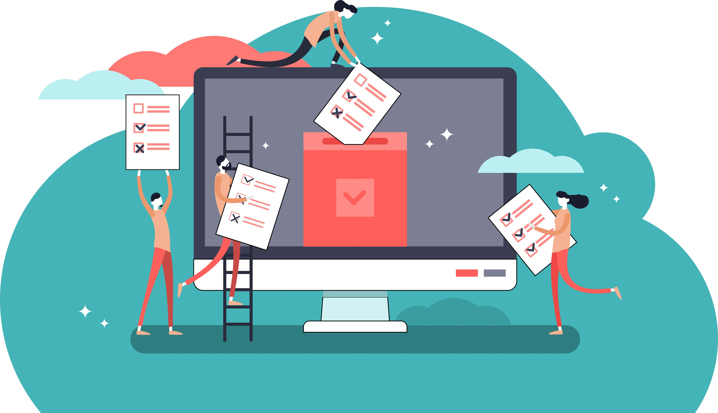

First, discover automation opportunities for immediate impact
Get the highest ROI from automation
Analyze how people get work done with UiPath Task Mining
The most effective way to discover and prioritize easy- to-automate, repetitive tasks with fast ROI
Notes:
However, before we go to Process Mining, we should introduce Task Mining. Task Mining is a companion product to Process Mining and also part of the UiPath Discovery toolset. Task Mining is a critical way to deliver insights on a desktop level.
The Task mining product records desktop-based clicks and keystrokes, and it uses AI to analyze how people get work done, making it the most effective way to prioritize those easy-to-automate, repetitive tasks with fast ROI.

Slide 6
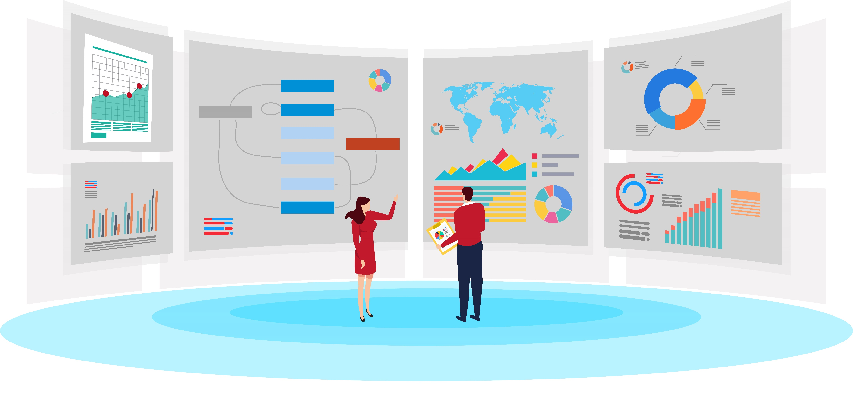

Then, take a holistic approach to process optimization
Get the highest ROI from automation
Take the automation journey to the next level with UiPath Process Mining
Connect: Access process data from your ERP, BPM or CRM systems
Configure: Add Tags and KPI’s to data to align outcomes with strategic business goals
Visualize: Obtain a fact-based representation of complex processes, showing all inefficiency and risk
Notes:
Then, using Process Mining, organizations can take a holistic approach to end-to-end process optimization, that will propel their automation to greater heights. It visualizes complex end-to-end processes, simply and intuitively, showing all inefficiency and risk, so that clients can discover new areas for optimization.

Slide 7

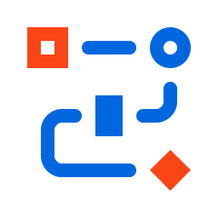

Who are the buyer personas for Process Mining?
Business-driven
COO, CFO, Global Process Owners
Drive digital transformation
Keep company processes agile and resilient to external pressures
Overall better insight into processes and optimization areas
Vision-driven
Chief Information Officer (CIO), Chief Data Officer (CDO)
Tap into highly valuable, existing enterprise data
Securely equip business users with valuable, data-driven insights about key business processes
RPA-driven
RPA CoE
Cares about finding new ways to optimize the use of automations and to scale that in their company.
Technical Sceptics
IT, Business Intelligence Analysts, Data Scientists
Cares about good use of data, technology and IT governance in a way that it doesn’t interfere with their current work. These are not decision makers, but they can raise objections.
Notes:
Let’s now introduce the three different buyer groups for process mining, which is similar to the buyer personas for RPA, but includes one new group: Global Process Owners
The first group is business-driven. These are COOs, CFOs and global process owners who are concerned with business outcomes of specific processes, operational efficiency and reducing cost. They would use process mining to drive digital transformation and making processes more resilient to external pressures.
The second group are vision driven, this includes CIOs and CDOs. They want to maximize use of data, so can use process mining to tap into existing collections of highly valuable data, equipping business users with data-driven insights about their processes.
The third group are RPA driven. This is the RPA CoE or similar, who are looking for new ways to optimize the use of automations and to scale automation within their company, while understanding the impact of automation on the end-to-end process.
There may also be process mining sceptics, who might come from IT, business intelligence or data science. They care about good use of data, technology and IT governance in a way that doesn’t interfere with their current work. They are not decision makers, but they may raise objections to process mining due to it being an emerging technology.

Slide 8
What is a process in Process Mining?
From Process Mining perspective, a process is an end-to-end, chronological sequence of steps, who’s definition is extracted from data systems (databases underlying ERP, CRM, workflow tools etc.).
Examples of Process and their Case ID’s.
Process | Case ID
Purchase-to-Pay | Purchase Order No.
Accounts Payable | Invoice No.
Order-to-Cash | Sales Order No.
Accounts Receivable | Invoice No.
Incident Management | Incident Ticket No.
Change Management | Change Ticket No.
Claims Management | Claims No.
Notes:
For licensing purposes in process mining, a process is defined as follows: an end-to-end, chronological sequence of steps, who’s definition is extracted from enterprise applications such as ERP and CRM.
In order to build this process definition, Process Mining uses a Case ID. Every process in process mining has a unique Case ID. An example of the Case ID for Procure to Pay is Purchase Order. The Case ID for the Accounts Payable process is a Purchase Invoice.

Slide 9
Typical Processes - Introduction
Process | Tier | 1. Function(s) | 1. Owner | 2. Key system | 3. Typical Metrics
Purchase-to-Pay | 1 | Purchasing | COO, Head of Purchasing, Global P2P Owner | SAP, Oracle, JDE | Cycle time, Straight-through Ratio, Exception Rate
Accounts Payable | 1 | Finance | CFO, Global AP Process Owner | SAP, Oracle, JDE | Cycle time, transaction cost, electronic ratio
Order-to-Cash | 2 | Finance | COO, Head of sales, Global O2C Owner | SAP, Oracle, JDE | DSO, Rev%, matching ratio
Accounts Receivable | 2 | Finance | CFO, Global AR Process Owner | SAP, Oracle, JDE | Turnover ration, CEI, DSO, ADD
Incident Management | 2 | IT, Customer support | CIO, | ServiceNow | MTR, MTBF, MTTR
Change Management | 2 | IT, Customer support | CIO | ServiceNow | ITIL set
Claims Management | 2 | Operations | Head of Claims Mgt., CFO | SAP | Avg Cost/Claim, Avg Time/Settle, Loss Ratio
Other than the typical owners of a process, Internal Audit, Operations Excellence and similar functions are typically also interested in Process Mining and can be adressed/included as possible buying personas or at least influencers and supporters.
Notes:
While Process Mining technology can be applied to many different processes, the market and our customers tend to focus on the high-impact processes of which a sample list is shown here. Purchasing, Finance, Supply Chain, IT, and Operations are the departments with the most take-up of Process Mining solutions, but Tax, HR, and industry-specific departments like Claims Processing also find high-impact use of the technology.
It is important for you to think about 3 key aspects of the target process at your customer:
Which department and global owner do I target
What underlying systems does my customer operate
What are the key Performance Metrics my customer is looking to impact.
The last point is homework for you as the sales person. Just like with our value-based approach to selling RPA, you should know what the key metrics are for each process you are discussing with your customers. For example, purchase-to-pay’s metrics include overall cycle-time, the time it takes to complete a transaction, or straight-through ratio, the percentage of transactions that processed without exception. You can appreciate that these metrics can be impacted by increased insights and automations. And the reason the Global Process Owner for P2P will want to talk to you is because you can demonstrate how Process Mining and RPA can affect those metrics.

Slide 10
The Three Tiers of Processes
We distinguish processes into three tiers. This distinction provides information about how experienced we are with the respective processes in the respective systems.
Tier 1
Tier 2
Tier 3
UiPath is familiar with the process and the system
Multiple implementations of this combination of process and system are performed by UiPath
In many cases, the Out-Of-The-Box data transformation connector is available
UiPath is familiar with the business analysis of these processes
UiPath is familiar with the data structure
OR
The customer can fill in the UiPath template Excel (here)
UiPath has limited knowledge of the process or the system
Some implementations of this combination of process and system are performed by UiPath
There is no Out-Of-The-Box data transformation connector available
UiPath is familiar with the business analysis of these processes
UiPath has seen processes with a comparable data structure of that system
UiPath has very limited knowledge of the process and the system
No implementations of this combination of process and system are performed by UiPath
There is no Out-Of-The-Box data transformation connector available
UiPath is not familiar with the business analysis of these processes
UiPath might have seen processes with a comparable data structure
Notes:
Process Mining can be used on almost any process and in combination with any system, however our sales strategy will focus on a select number of processes and systems. For this reason we have divided processes into three tiers.
Tier 1 processes are processes we know well, and in many cases, an out-of-the-box connector is available.
Tier 2 processes are processes that we have limited experience with, but we know the underlying systems well
Tier 3 processes are processes that we have very limited knowledge of.
UiPath Process Mining sales will mainly focus on Tier 1 and Tier 2 processes.
More information on the Three Tiers can be found in additional resources at the end of this presentation.

Slide 11
The Three Tiers of Processes
We distinguish processes into three tiers. This distinction provides information about how experienced we are with the respective processes in the respective systems.
Tier 1
Tier 2
Tier 3
Purchase to Pay / SAP
Accounts payable / SAP
Order to Cash / SAP
Accounts receivable / SAP
Purchase to Pay / Oracle
Accounts payable / Oracle
Order to Cash / Oracle
Accounts receivable / Oracle
Production / SAP
Quality Management / SAP
Meter to Cash / SAP
Incident Mgt. / ServiceNow
Claims Management
All other processes
All other systems
Especially homegrown applications and systems
Notes:
Here is an overview of the processes that fall in the three tiers.
Tier 1 includes the Purchase to Pay and Accounts Payable for SAP
Tier 2 processes includes various financial and operational processes for SAP, Oracle and ServiceNow
Tier 3 covers all other processes and systems, especially homegrown applications and systems
More information on the Three Tiers can be found in additional resources at the end of this presentation.

Slide 12
Process Mining Sales Motion
Focus on Tier 1 processes in demo and PoC results in faster sales cycle
Delivery projects executed by focused Process Mining partners
Opportunity Initiation
Sales Rep reach out
Campaign / events
Opportunity Differentiation
Presentation
Demo
RFP Response
Data Discovery Workshop
(Tier2)
2-8 hours
Reviews the customer’s datasets
Proof of Concept (Tier 1)
2-4 days
Single Process Assessment
Known process
Contract
1-5 license commitment
Service Delivery Project
2-4 week engagement
Delivery Partner-led
Process
Step
Pilot (Tier 2-3)
2-week paid engagement
Delivery Services / Partner-led
Sales (Rep + Specialist)
Pre-sales
Sales
Pre-sales
CSM
Pre-sales
Data Analysts
Sales
Pre-sales
CSM
Prof. Services
Delivery Partner
Sales
Legal
Prof. Services
Data Specialist
Process Analyst
PM
CSM
RPA Developer
Functions
Involved
Notes:
There are several nuances to the Process Mining sales motion that are important for you to understand.
First off, especially for tier 2 processes, a data discovery workshop might be set up by your pre-sales team to help establish the specifics of the customers intended data sets.
The next stage can either involve a Proof of Concept or a Pilot. A PoC is a 2-5 day pre-sales event demonstrating the viability of UiPath process mining using a limited customer data set. This is only possible for Tier 1 processes
The alternative option is a Pilot, which is a 2-week paid engagement that is only applicable to Tier 2 and 3 processes.
The service delivery project is a project to implement one process. Implementation time is between 2-4 weeks.
There is no one-path to process mining implementation, a combination of these sales tools may be necessary depending on the requirements and situation of the prospect.

Slide 13
Process Mining Sales Specialists – introducing our sales overlay structure
Direct Sales Org.
Partner Sales Org.
Prof.
Services
PM Sales
Specialists
PM Prof.
Services
Experts
Process Mining ​
Sales Overlay​
Team
Delivery Team
Process Mining Sales Specialists bring expertise, focus, and support to every process mining opportunity for customers and for partners
Notes:
The sales structure for process mining differs from the usual UiPath sales structure. An overlay team of Process Mining Sales Specialists is being added to help drive and support you with Process Mining specific knowledge, and access to our Process Mining community..
You as the owner of the account will continue to lead the conversation with the prospect, but the Sales Specialist brings extra know-how and support for Process Mining opportunities or deals that have PM SKUs in them.

Slide 14


How do clients…
Maximize the ROI from automation?
Optimize how robots, systems and people interact in a process?
Engage business users to realize change?
Accelerate RPA programs?
The answer lies in processes…
Notes:
Let’s now look into the unique value of Process Mining for customers:
The client is already running a successful automation program, but they would like to do more.
How can they:
Maximize the ROI from automation
Optimize how robots, systems and people interact in a process
Engage business users to realize change
And ultimately, accelerate and scale RPA?
The answer lies in processes…

Slide 15
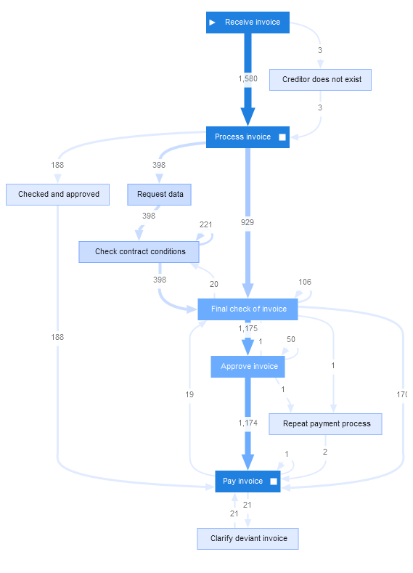
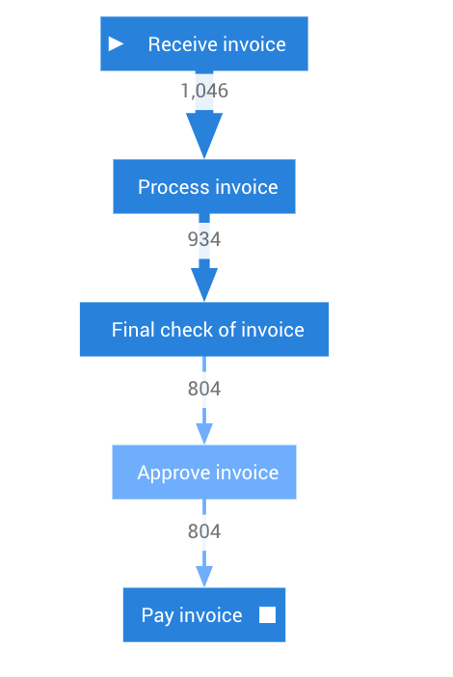
How can you uncover your processes?
The expected process
The actual process
Notes:
Most people have an idea of how a process runs, but digging a bit deeper, the process isn’t as straightforward as you might think.
Trends, patterns and details of how an entire process runs are waiting to be discovered. Let’s look into how it works.

Slide 16
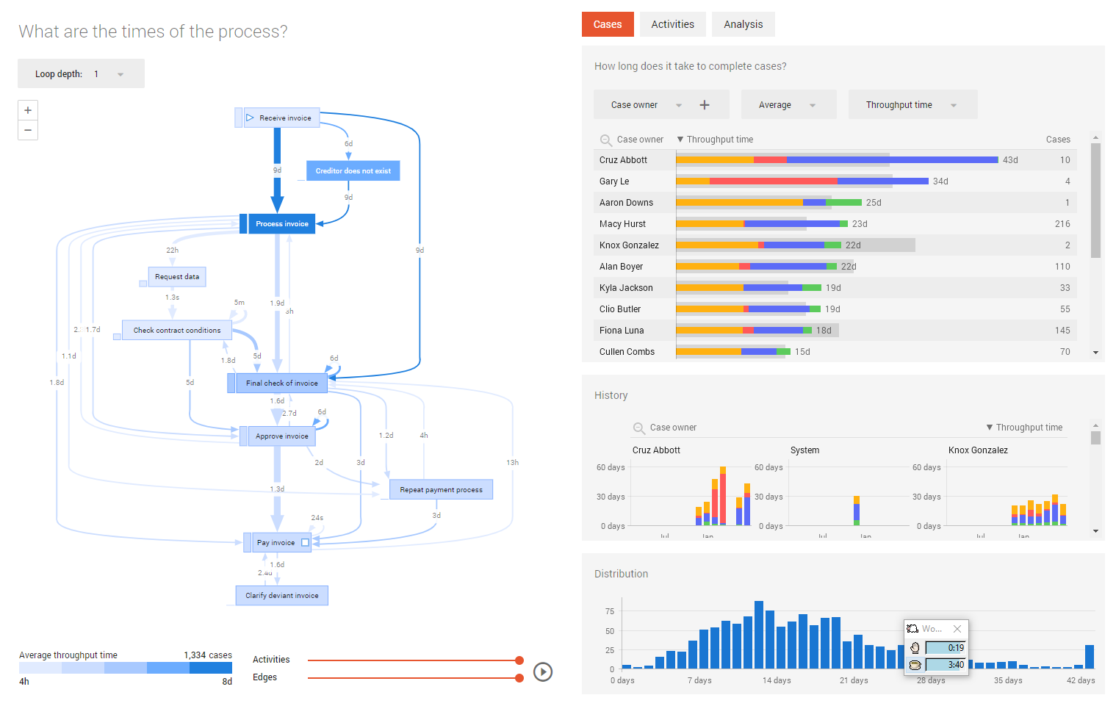
A holistic look at end-to-end process optimization
Visualize end-to-end process to see the impact of automation
Notes:
The first step of Process Mining is connecting it to the data source. UiPath process mining can be connected to many different IT systems. The most common you will come across are SAP, Salesforce, ServiceNow, Oracle and Microsoft product suites. Using event logs, the data is then transformed into a process graph, allowing customers to visualize their end-to-end processes holistically, revealing all process bottlenecks, deviations, inefficiency and risk.

Slide 17
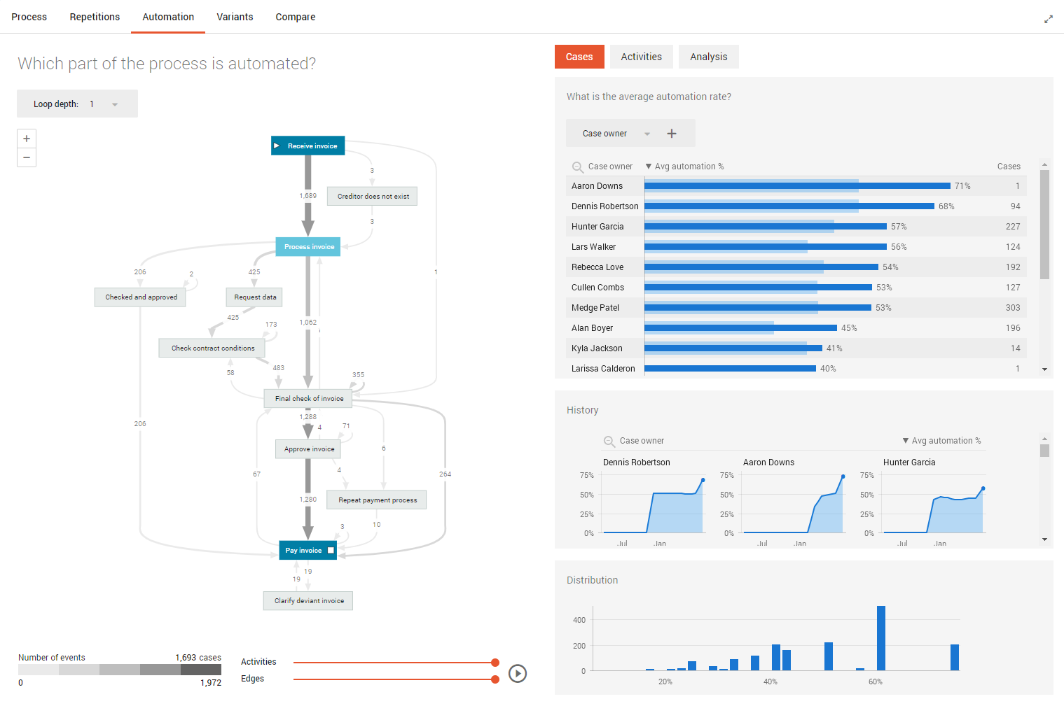
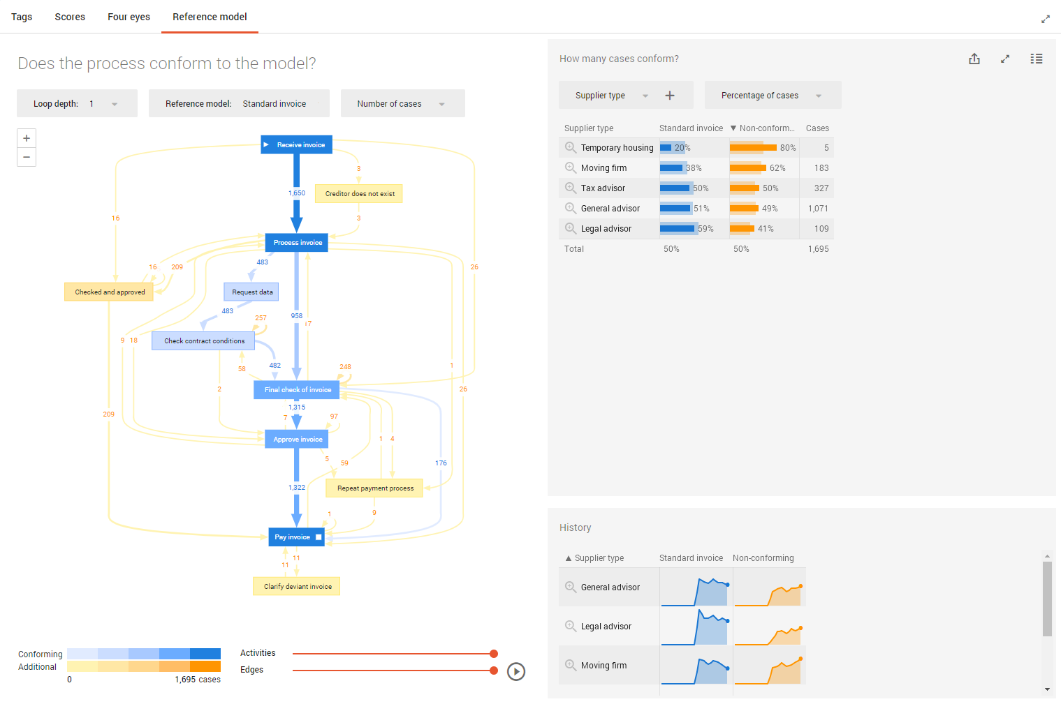
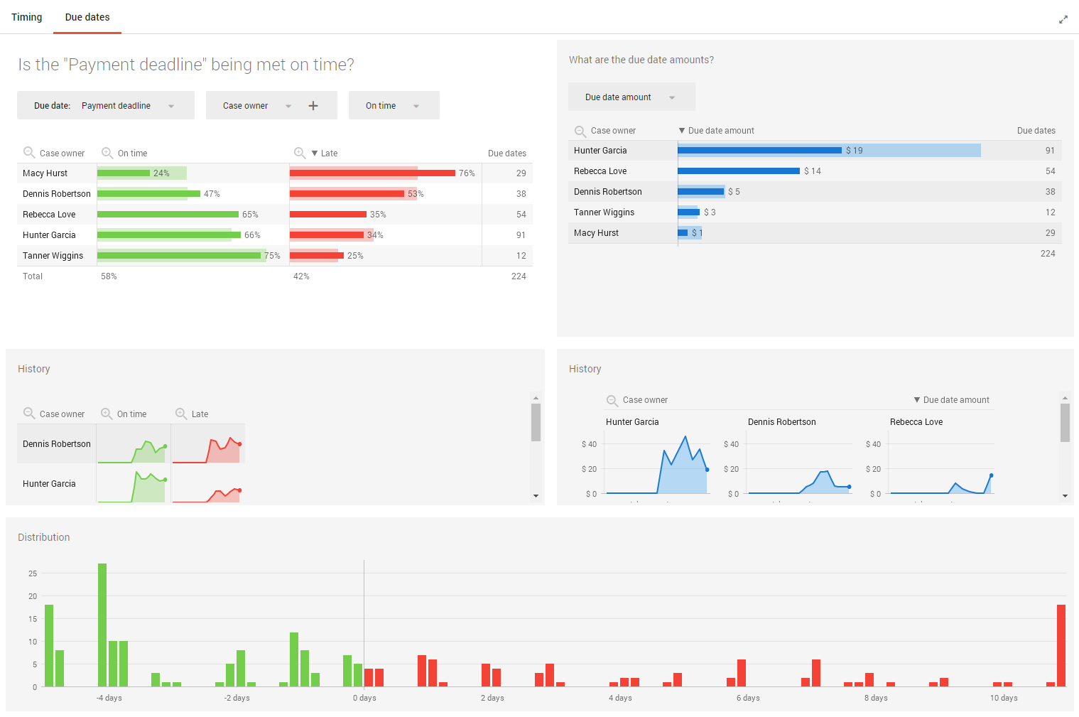
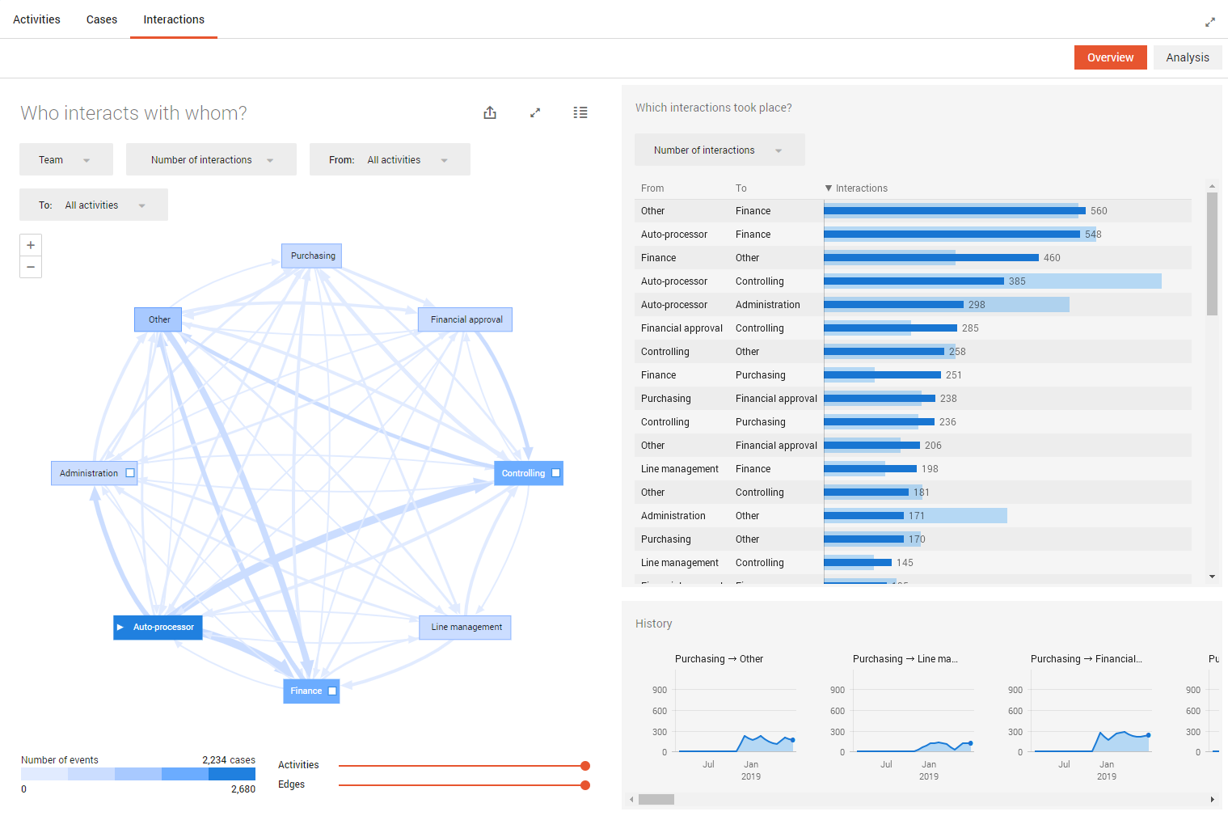
A holistic look at end-to-end process optimization
Out-of-the-box dashboards yield many different perspectives
Notes:
AppOne, our ready-to-use process mining template, contains predefined dashboards so you can look at your process from different perspectives.
For example, which part of the process is automated?
How fast is the process executed, and did we meet all our deadlines?
Does the process conform to the model?
How do different teams, countries or users interact in the process?

Slide 18
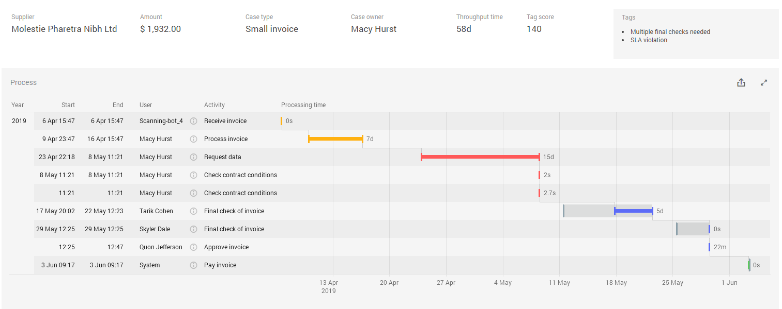
A holistic look at end-to-end process optimization
Dive down to the deepest details for full visibility into process instances
Notes:
Process Mining allows users to go from a helicopter view of the end-to-end process to the deepest details. This makes it easy to understand what is happening by viewing individual process instances.

Slide 19
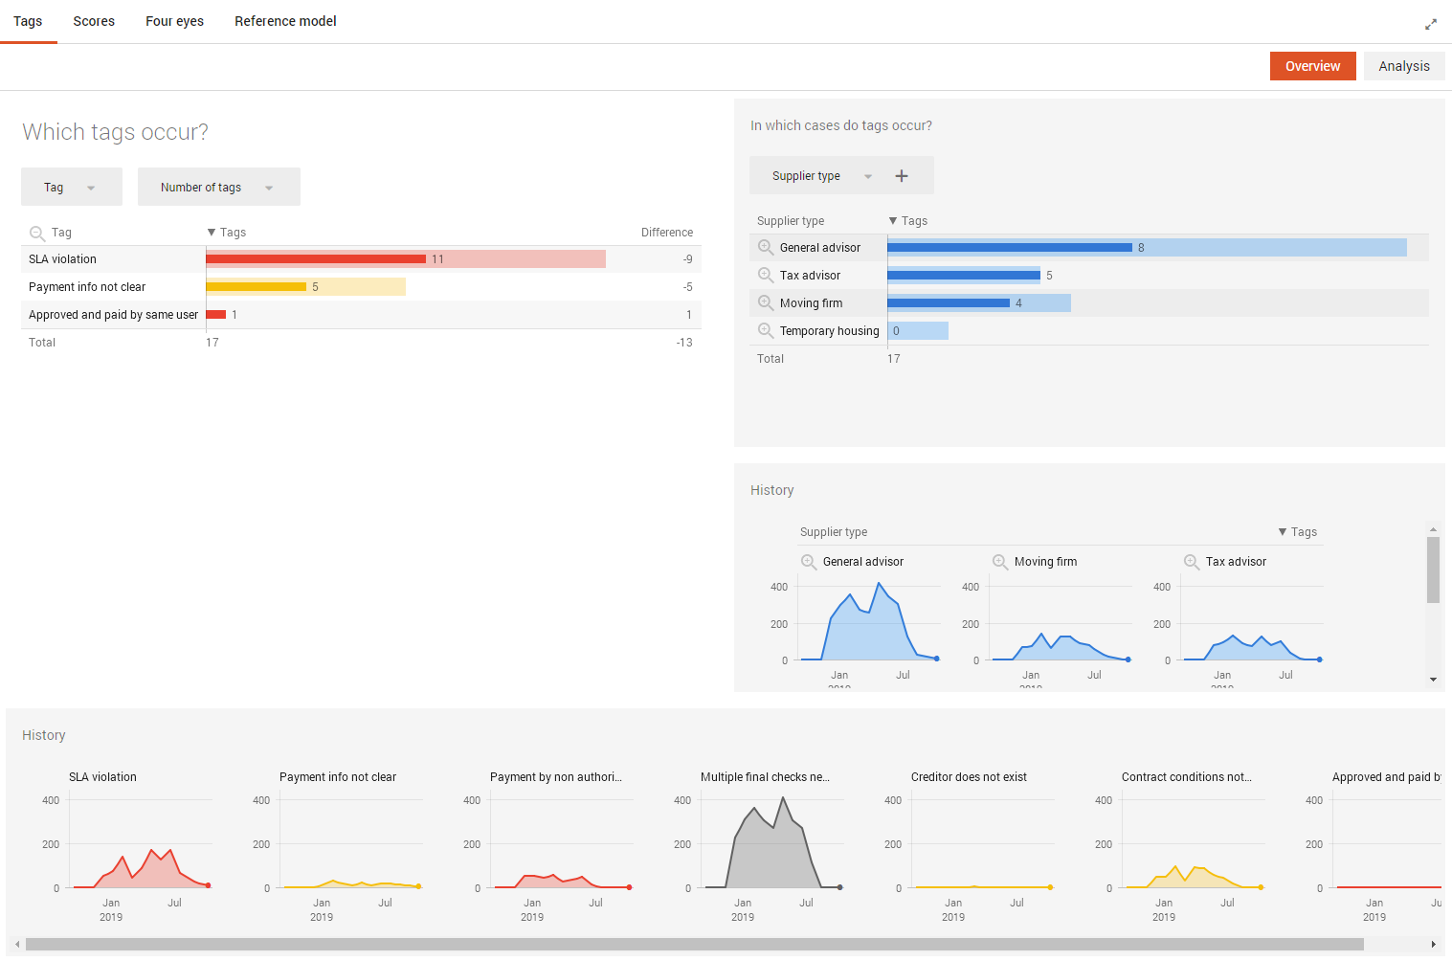
A holistic look at end-to-end process optimization
Add business logic to data in the form of KPIs and tags, to align process outcomes with strategic business goals
KPIs
Invoice processing time
Purchase order cycle time
% of non-conforming processes
Number of process variants
Tags
Separation of duties (SOD)
Service Level Agreements (SLA)
Many other exceptions or violations
Notes:
Customer-specific business logic can be added in the form of tags and KPIs. These make the desired business outcomes explicit and make it easy to see whether you are meeting those or not. Example KPIs include Invoice processing time, PO cycle time, % of non-conforming processes. Tags are a unique feature of UiPath Process Mining. They make it possible to define process-specific outcomes that you want to prevent. Examples are SLAs violations, or separation of duties concerns.

Slide 20








Continuously monitor and improve the process
Optimize how robots, systems and people interact in a process
Systems & People
Optimize
1. Understand
2. Optimize
Get insights about processes and how automation performs in the context of the end-to-end-process
Understand
Act on those insights by strengthening interactions within the end-to-end processes (systems, people and robots)
Robots
Notes:
The great value of process mining lies in its extensive continuous monitoring capabilities, allowing businesses to constantly have a view of their process, to optimize how their robots, people and systems interact.
There are two parts to continuous monitoring and improvement. The first is understanding the process, for instance, how does automation perform in the context of the end-to-end process?
The second is optimizing the process using those insights, taking steps to strengthen the interactions between robots, people and systems.

Slide 21
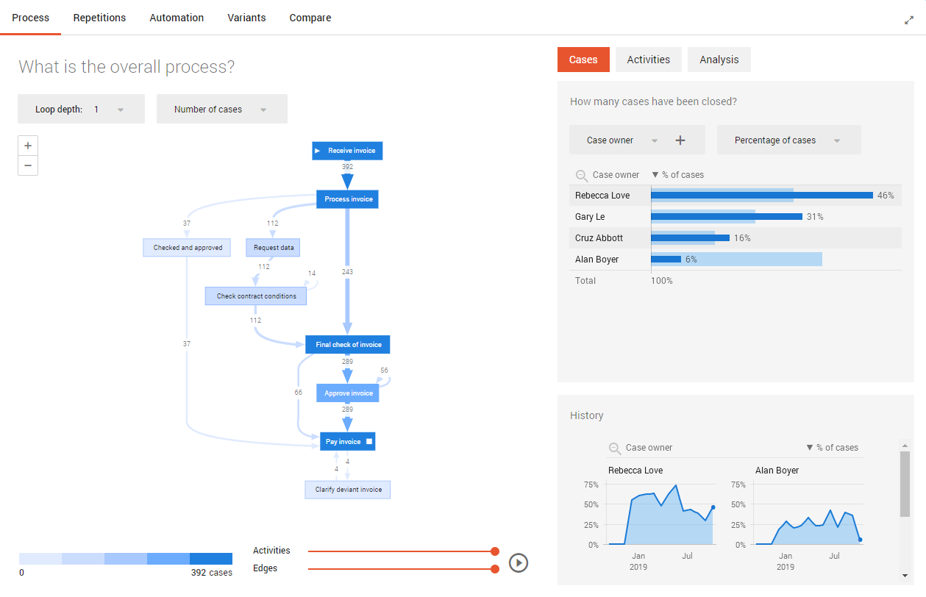
Continuous Improvement Cycle
Continuous monitoring capabilities focus on impact of changes
Notes:
The product contains features to facilitate continuous monitoring of the process, like compare bars and history charts. They make it easy to see the impact of changes on a regular basis, every month, every week, every day.

Slide 22
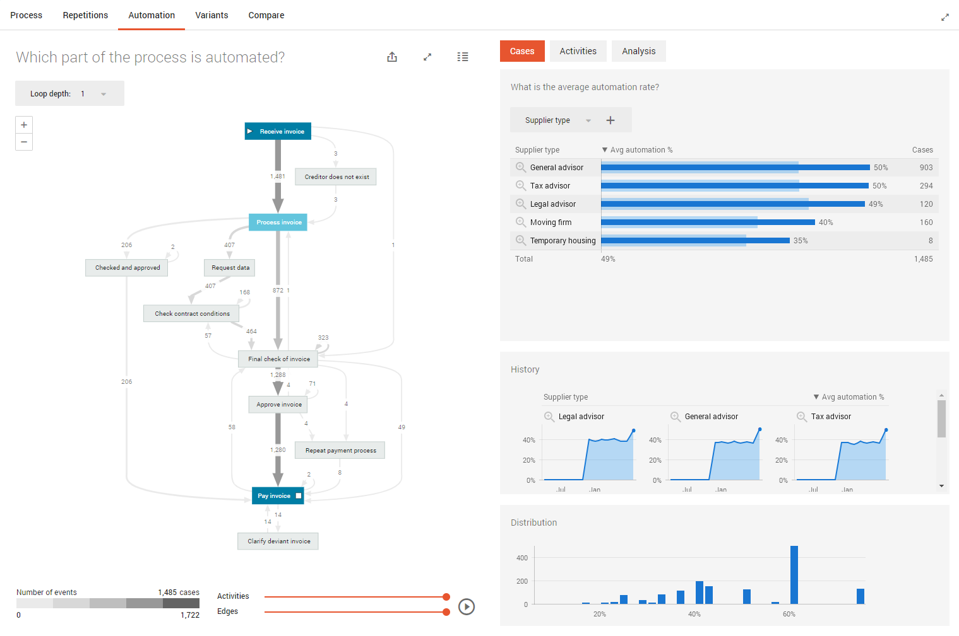
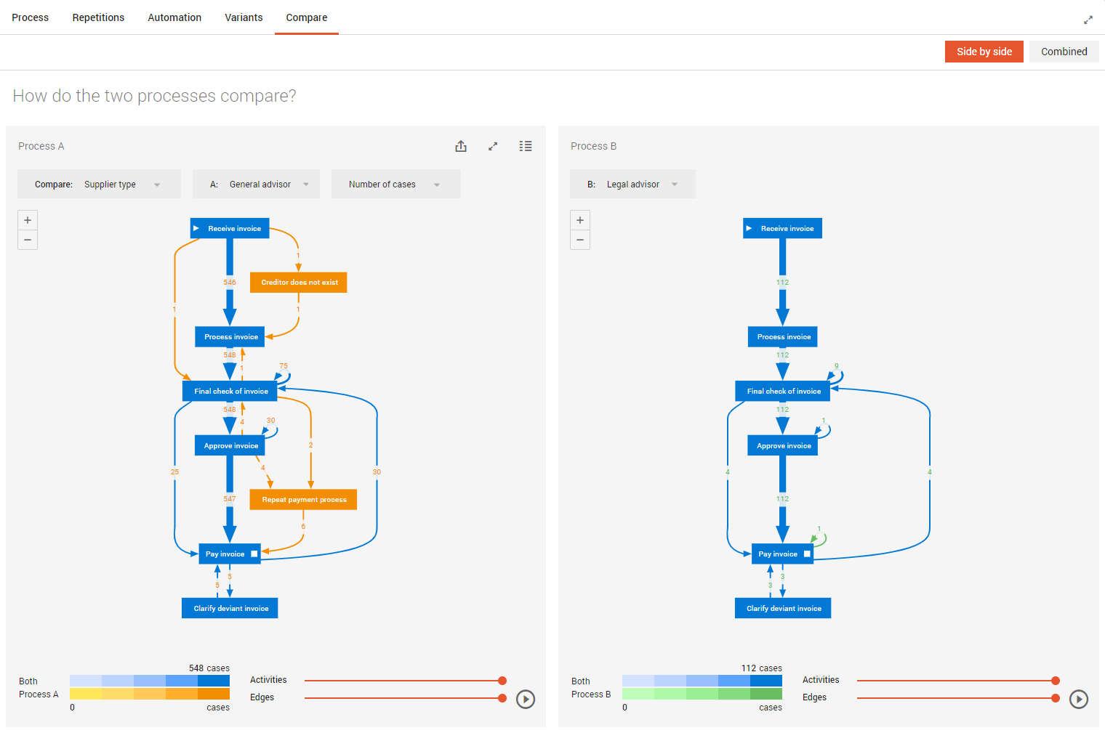
Continuous Improvement Cycle
See the progress of your
automation initiatives
Compare processes to evaluate change before and after automation
Notes:
Continuous monitoring allows you to evaluate your automations in the context of the end-to-end process and compare processes over two time periods to better understand the impact of changes. When you make changes to one step in your process, it’s often hard to predict how it will affect the whole system. With Process Mining, you can see exactly that.

Slide 23
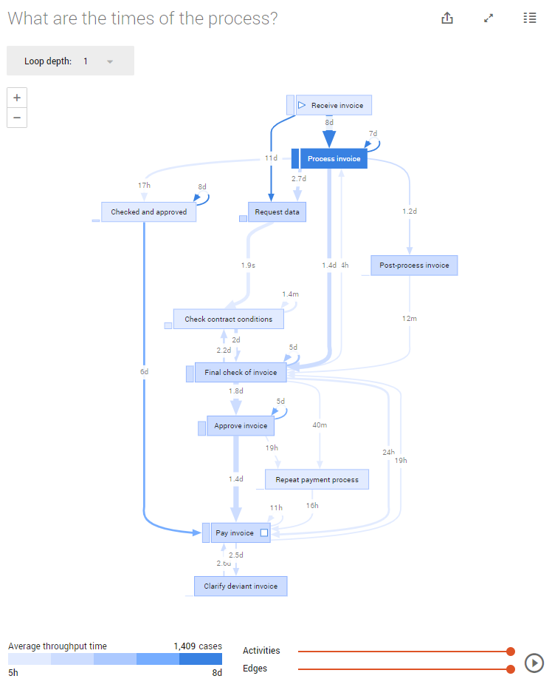
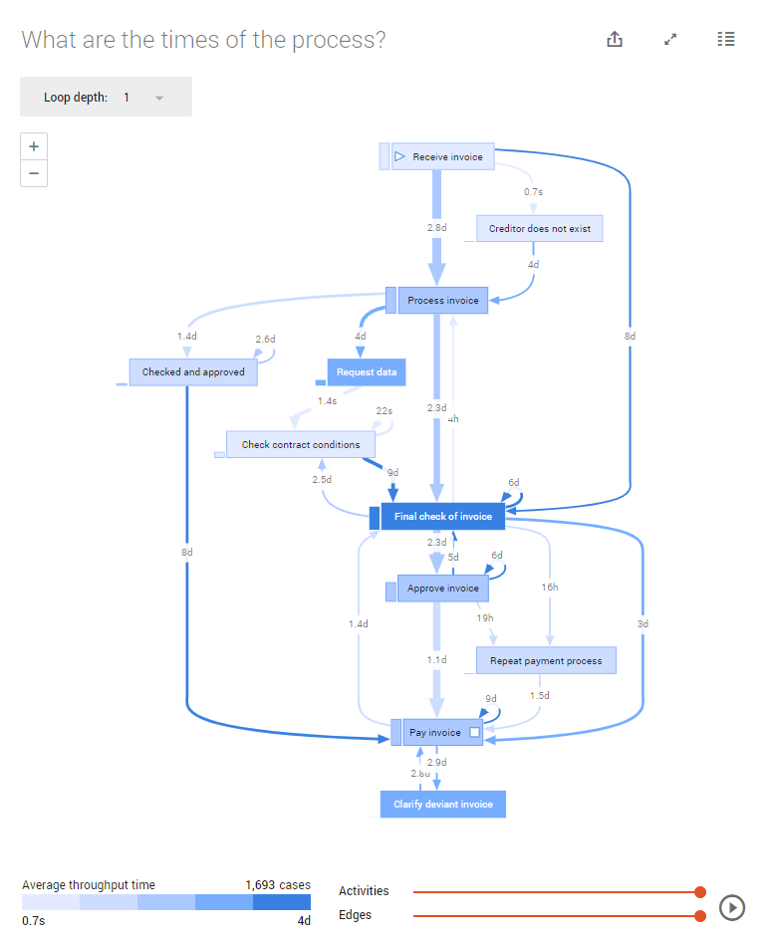
Continuous Improvement Cycle
Uncover where bottleneck shifts after
automation initiatives
Notes:
Process Mining gives you the ability to see whether new bottlenecks have emerged after implementing automation, and what the overall impact is on your end-to-end process.

Slide 24

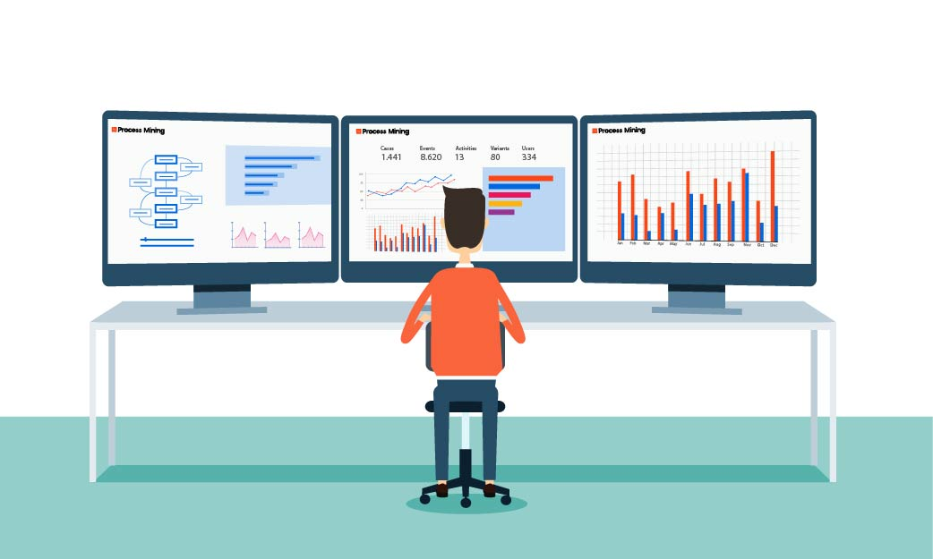
Democratized insights for business users
Engage business users to change processes for the better
Use intuitive, easy-to-use visualizations and dashboards to drive bottom-up process change
Focus stakeholders around a single source of truth to achieve desired business outcomes
Engage process owners and users as active participants in process optimization
Notes:
Process mining was created for business users, and no technical background is required for a process user license. Using intuitive, easy-to-use visualizations and dashboards, users are engaged as active participants in process optimization. This activates them to work towards clear common goals to step-by-step improve the whole end-to-end process. Optimizations can come in the form of ideas for new automations, or new ways to work better with the current automations.

Slide 25
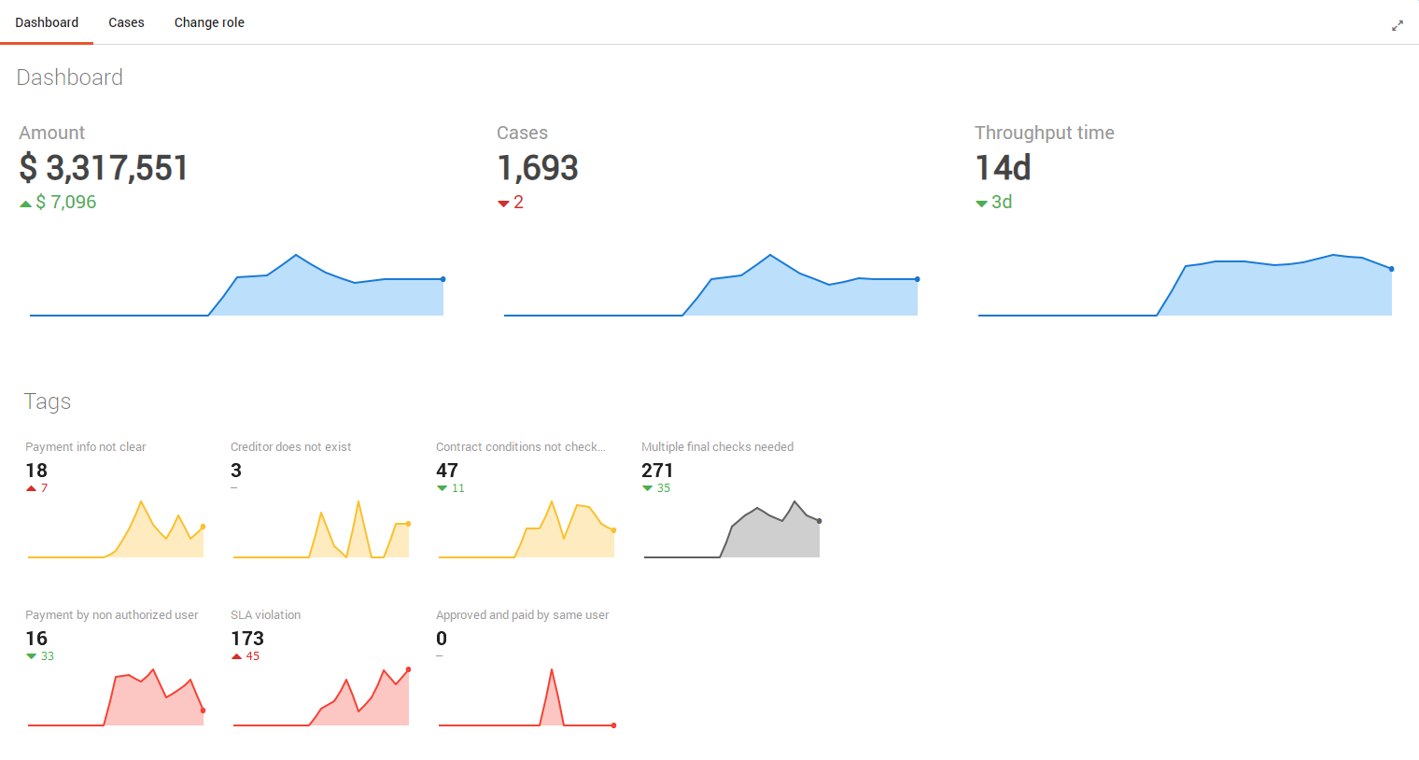
Democratized insights for business users
Role-based access and easy KPI dashboards allow everyone to be actively involved in driving continuous process improvement
Notes:
The platform has role-based access and easy KPI dashboards that were designed for business users. This allows the people directly involved in the process to be the drivers of continuous process improvement.

Slide 26


Accelerate the Automation Flywheel Enable end-to-end automation, from process discovery to robot implementation
Accelerate RPA programs
Continuous
Drive bottom-up process
Optimization with easy visualizations and Insights that engage business users
Understand RPA in the context of the end-to-end process, in order to continuously optimize interactions between robots, people and systems
Holistically discover and prioritize
automation with the highest ROI with
task mining and process mining
Holistic
s
Democratized
Notes:
In summary, Process Mining accelerates the automation flywheel by providing
a holistic view of end-to-end processes
continuously monitoring and improving those processes and;
democratizing insights to process users to drive process optimization.

Slide 27




Customer Value Drivers
Accelerate Growth & Operational Efficiency
Spend less time and costs on operational tasks and more on the real business investments
Improve Customer Experience
Win customers’ respect – accelerate the speed of response to show how you value their time
Improve Employee Experience / Happiness
Save employees from mundanity and let them focus on higher value tasks and objectives
Operational Resiliency & Risk Mitigation
Minimize and manage enterprise risks, and ensure compliance & operational resiliency
Notes:
How does Process Mining contribute to the Customer Value Drivers?
1. It allows you to continuously monitor and optimize your processes for operational efficiency
2. Better, more efficient internal and external processes leads to an improved customer experience
3. Better processes means your teams are working at their optimal best
4. Process mining leads to stronger, more resilient processes. Process aren’t static, they need to be continuously adjusted to keep up with internal and external developments. Process Mining gives you an x-ray view of your processes at all times.

Slide 28



UiPath Process Mining Licenses
Process License
One license required per process, for example, Purchase-to-Pay, Order-to-Cash (non-production license available)
Process User License
Full insight into processes happening in the organization
Ability to monitor KPIs and detect bottlenecks
Ability to discover RPA opportunities
Developer User License
Fully access the design and development functionality of UiPath Process Mining
Develop, customize and administrate platform applications
Notes:
For Process mining, we offer the following three licenses types: a License per Process User, a License per Developer user, and a License per process-mined process.
The process user can view dashboards to get insights in their processes and can monitor them over time.
The developer user can set up the data extraction and transformation to make process mining possible.
For each process the customer wants to process mine, a process license has to be acquired.
There is a non-production version available for this license, if customers want a separate development or testing environment.
Finally, to get started with process mining, each new customer must acquire the appropriate services. To make this easy, there is a Process Mining Starter Pack, please see additional resources.

Slide 29
Thank you
Notes:
I hope this information was valuable to you today, and thank you for attending this course.

